Slide 1
LESSON 4.2
Hybridization

Slide 2
LESSON GOALS
I can identify and explain the relationships between Lewis structures, electron domains, molecular geometries, and types of hybridization

Slide 3
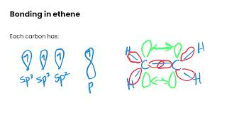
TASK 1: LEARN (MUST DO)
Individually or with a partner:
Watch the hybridization video
Complete the guided note

Slide 4
TASK 2: PRACTICE
Individually or with a partner:
Complete the hybridization practice (answers included)
Note: There are must do, should do, and aspire to do questions included in this practice!

Slide 5
TASK 3: MASTERY CHECK (MUST DO)
Individually:
Complete the hybridization mastery check (see me when you are ready!)

